Slide 1
Apache Spark

Slide 2
Apache Spark is an open-source cluster computing system that provides high-level API in Java, Scala, Python and R. It can access data from HDFS, Cassandra, HBase, Hive, Tachyon, and any Hadoop data source. And run in Standalone, YARN and Mesos cluster manager.
2. What is Spark?
Apache Spark is a general-purpose & lightning fast cluster computing system. It provides a high-level API. For example, Java, Scala, Python, and R. Apache Spark is a tool for Running Spark Applications. Spark is 100 times faster than Bigdata Hadoop and 10 times faster than accessing data from disk. Spark is written in Scala but provides rich APIs in Scala, Java, Python, and R. It can be integrated with Hadoop and can process existing Hadoop HDFS data.
3. History Of Apache Spark
Apache Spark was introduced in 2009 in the UC Berkeley R&D Lab, later it becomes AMPLab. It was open sourced in 2010 under BSD license. In 2013 spark was donated to Apache Software Foundation where it became top-level Apache project in 2014.

Slide 3
4. Why Spark?
In the industry, there is a need for a general-purpose cluster computing tool as:
Hadoop MapReduce can only perform batch processing.
Apache Storm / S4 can only perform stream processing.
Apache Impala / Apache Tez can only perform interactive processing
Neo4j / Apache Giraph can only perform graph processing
Hence in the industry, there is a big demand for a powerful engine that can process the data in real-time (streaming) as well as in batch mode. There is a need for an engine that can respond in sub-second and perform in-memory processing.
Apache Spark Definition says it is a powerful open-source engine that provides real-time stream processing, interactive processing, graph processing, in-memory processing as well as batch processing with very fast speed, ease of use and standard interface. This creates the difference between Hadoop vs Spark and also makes a huge comparison between Spark vs Storm.

Slide 4
There is a common belief that Apache Spark is an extension of Hadoop, which is not true. Spark is independent of Hadoop because it has its own cluster management system. It uses Hadoop for storage purpose only.
The key feature of Spark is that it has in-memory cluster computation capability. That increases the processing speed of an application. The in-memory computing means using a type of middleware software that allows one to store data in RAM, across a cluster of computers, and process it in parallel.

Slide 5
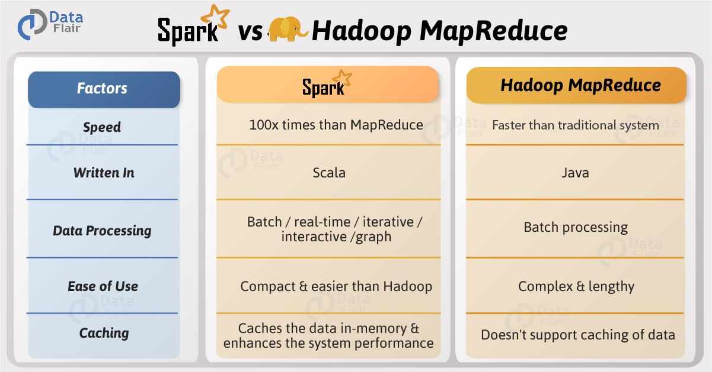

Slide 6
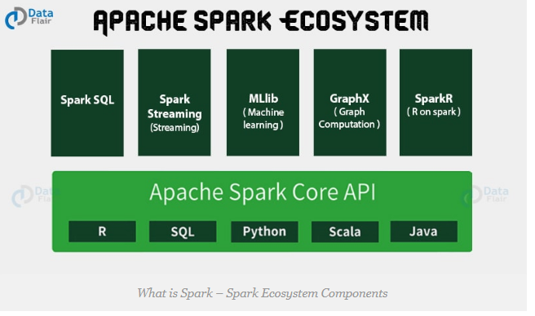
5. Apache Spark Components
Apache Spark puts the promise for faster data processing and easier development.
Apache Spark Ecosystem – Spark Core, Spark SQL, Spark Streaming, MLlib, GraphX, SparkR.
Following are 6 components in Apache Spark Ecosystem which empower to Apache Spark- Spark Core, Spark SQL, Spark Streaming, Spark MLlib, Spark GraphX, and SparkR.

Slide 7
Submitting a spark job
spark-submit --class sparkWordCount.WordCounter --master local /home/cloudera/Desktop/sparkWordCount.jar /user/spark/sparkWordcount/hello.txt /user/spark/sparkWordcount/sparkoutput
public class WordCounter {
private static void wordCount(String fileName) {
SparkConf sparkConf = new SparkConf().setMaster("local").setAppName("Spark code two");
JavaSparkContext sparkContext = new JavaSparkContext(sparkConf);
JavaRDD<String> lines = sparkContext.textFile(fileName);

Slide 8
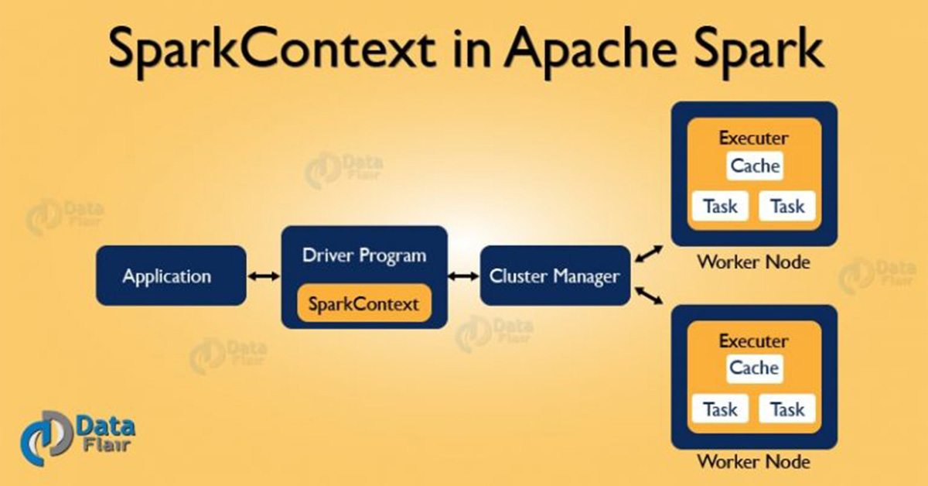
SparkContext is the entry gate of Apache Spark functionality. The most important step of any Spark driver application is to generate SparkContext. It allows your Spark Application to access Spark Cluster with the help of Resource Manager (YARN/Mesos). To create SparkContext, first SparkConf should be made. The SparkConf has a configuration parameter that our Spark driver application will pass to SparkContext.
After the creation of a SparkContext object, we can invoke functions such as textFile, sequenceFile, parallelize etc. The different contexts in which it can run are local, yarn-client, Mesos URL and Spark URL.

Slide 9
4. Stopping SparkContext
Only one SparkContext may be active per JVM. You must stop the active it before creating a new one as below: stop(): Unit It will display the following message: INFO SparkContext: Successfully stopped SparkContext
Apache Spark Executor for Executing Spark Tasks
some distributed agent is responsible for executing tasks, this agent is what we call Spark Executor.
The major advantage is, we can have as many executors we want. Therefore, Executors helps to enhance the Spark performance of the system.

Slide 10
Basically, we can say Executors in Spark are worker nodes. Those help to process in charge of running individual tasks in a given Spark job.
Moreover, we launch them at the start of a Spark application. Then it typically runs for the entire lifetime of an application. As soon as they have run the task, sends results to the driver. Executors also provide in-memory storage for Spark RDDs that are cached by user programs through Block Manager. In addition, for the complete lifespan of a spark application, it runs. That infers the static allocation of Spark executor. However, we can also prefer for dynamic allocation. Moreover, Sender Thread, it sends metricswith the help of Heartbeat and heartbeats. One of the advantage we can have as many executors in Spark as data nodes. Moreover also possible to have as many cores as you can get from the cluster. The other way to describe Apache Spark Executor is either by their id, hostname, environment (as SparkEnv), or classpath. The most important point to note is Executor backends exclusively manage Executor in Spark.

Slide 11
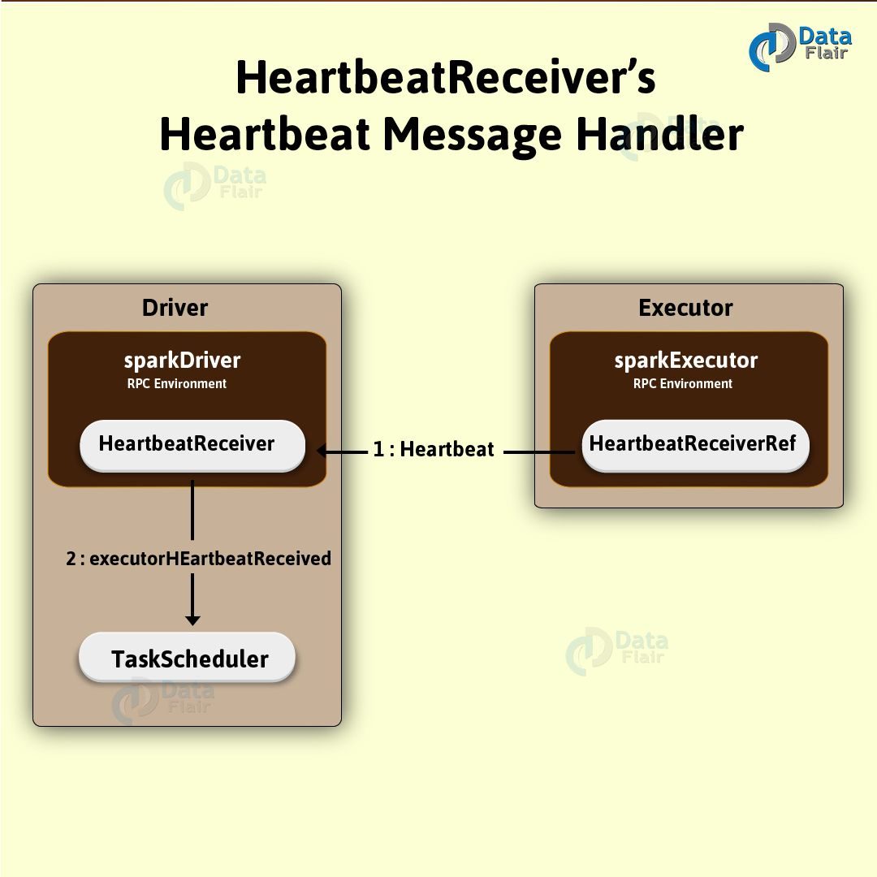

Slide 12
3. Conditions to Create Spark Executor
Some conditions in which we create Executor in Spark is:
1. When CoarseGrainedExecutorBackend receives RegisteredExecutor message. Only for Spark Standalone and YARN.
2. While Mesos’s MesosExecutorBackend registered on Spark.
3. When LocalEndpoint is created for local mode.
Creating Spark Executor Instance
By using the following, we can create the Spark Executor:
1. From Executor ID.
2. By using SparkEnv we can access the local MetricsSystem as well as BlockManager. 3. Moreover, we can also access the local serializer by it.
4. From Executor’s hostname.
5. To add to tasks’ classpath, a collection of user-defined JARs. By default, it is empty.
6. By flag whether it runs in local or cluster mode (disabled by default, i.e. cluster is preferred)

Slide 13
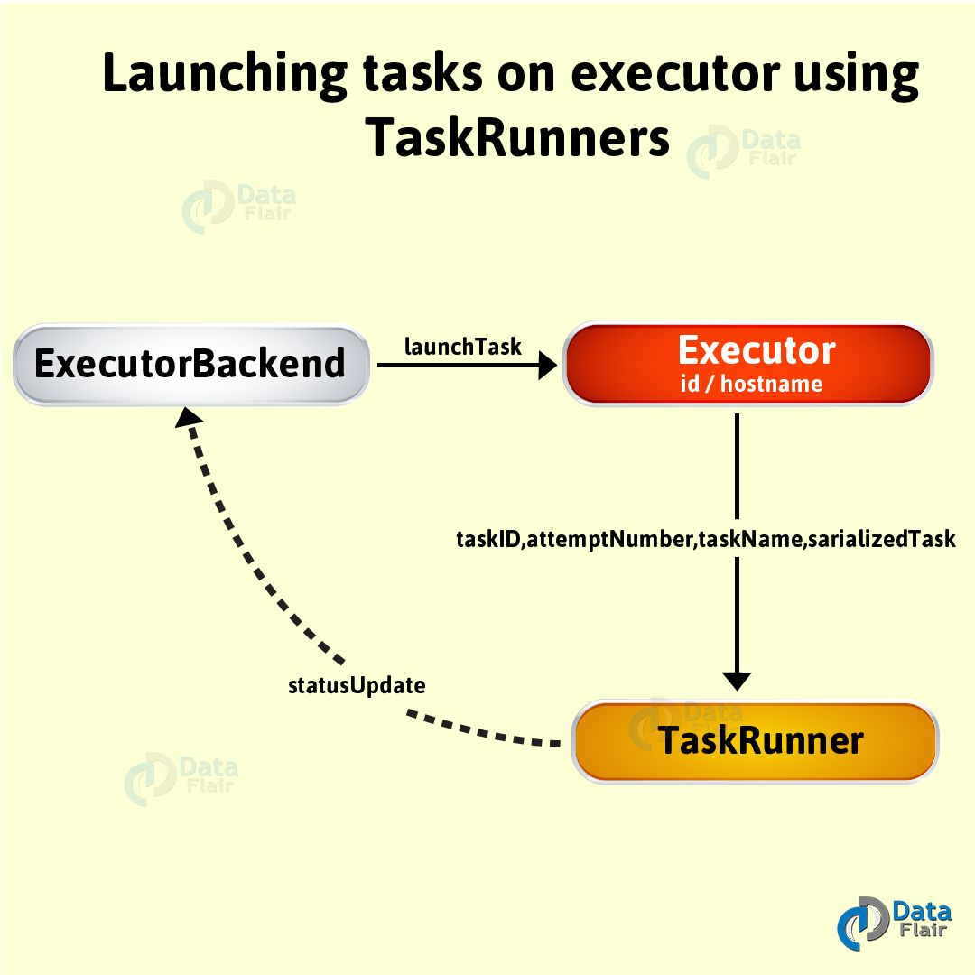
Moreover, when creation is successful, the one INFO messages pop up in the logs. That is: INFO Executor: Starting executor ID [executorId] on host [executorHostname]
5. Heartbeater — Heartbeat Sender Thread
Basically, with a single thread, heartbeater is a daemon ScheduledThreadPoolExecutor. We call this thread pool a driver -heartbeater.
6. Launching Task — launchTask Method
By using this method, we execute the input serializedTask task concurrently.
launchTask(
context: ExecutorBackend,
taskId: Long,
attemptNumber: Int,
taskName: String,
serializedTask: ByteBuffer): Unit
Moreover, by using launchTask we use to create a TaskRunner, internally. Then, with the help of taskId, we register it in the runningTasks internal registry. Afterwards, we execute it on “Executor task launch worker” thread pool.

Slide 14
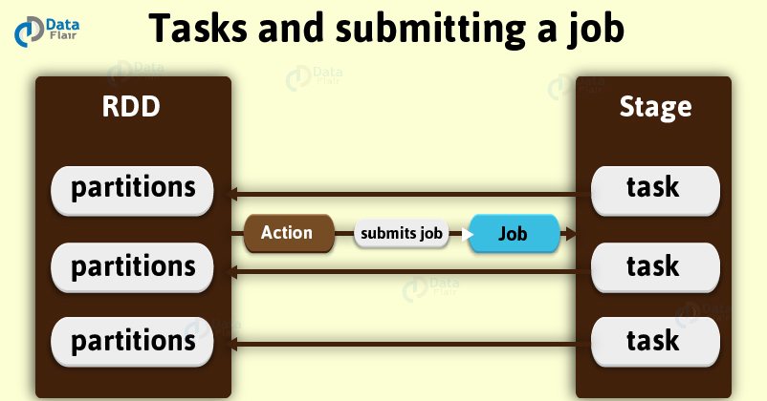
What are Stages in Spark?
A stage is nothing but a step in a physical execution plan. It is a physical unit of the execution plan. It is a set of parallel tasks i.e. one task per partition. In other words, each job which gets divided into smaller sets of tasks is a stage. Although, it totally depends on each other. However, we can say it is as same as the map and reduce stages in MapReduce.

Slide 15
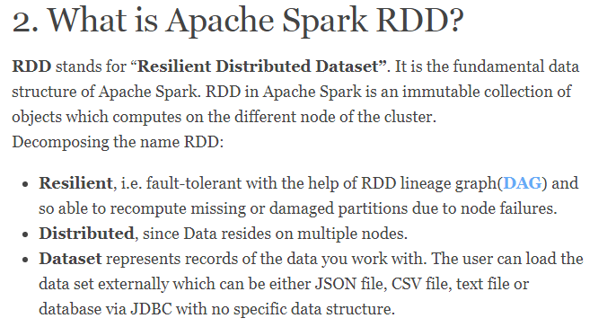
Hence, each and every dataset in RDD is logically partitioned across many servers so that they can be computed on different nodes of the cluster.
RDD is a distributed collection of data elements spread across many machines in the cluster. RDDs are a set of Java or Scala objects representing data.

Slide 16
(Directed Acyclic Graph) DAG in Apache Spark is a set of Vertices and Edges, where vertices represent the RDDs and the edges represent the Operation to be applied on RDD. In Spark DAG, every edge directs from earlier to later in the sequence. On the calling of Action, the created DAG submits to DAG Scheduler which further splits the graph into the stages of the task.
Spark RDD can also be cached and manually partitioned. Caching is beneficial when we use RDD several times. And manual partitioning is important to correctly balance partitions. Generally, smaller partitions allow distributing RDD data more equally, among more executors. Hence, fewer partitions make the work easy.
Programmers can also call a persist method to indicate which RDDs they want to reuse in future operations. Spark keeps persistent RDDs in memory by default, but it can spill them to disk if there is not enough RAM. Users can also request other persistence strategies, such as storing the RDD only on disk or replicating it across machines, through flags to persist.
Spark exposes RDD through language integrated API. In integrated API each data set is represented as an object and transformation is involved using the method of these objects.
To achieve fault tolerance efficiently, RDDs provide a restricted form of shared memory, based on coarse-grained transformation rather than fine-grained updates to shared state.

Slide 17
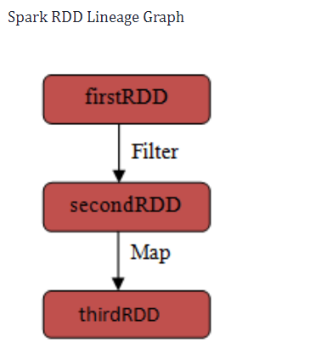
Now, How Does Rdd Helping for Fault Tolerance?
Since RDDs are created over a set of transformations , it logs those transformations, rather than actual data.Graph of transformations to produce one RDD is called as Lineage Graph.
For example –
firstRDD=spark.textFile("hdfs://...")
secondRDD=firstRDD.filter(someFunction);
thirdRDD = secondRDD.map(someFunction);
In case of we lose some partition of RDD , we can replay the transformation on that partition in lineage to achieve the same computation, rather than doing data replication across multiple nodes.This characteristic is biggest benefit of RDD , because it saves a lot of efforts in data management and replication and thus achieves faster computations.

Slide 18
3. Introduction to RDD Lineage
While we create a new RDD from an existing Spark RDD, that new RDD also carries a pointer to the parent RDD in Spark. That is the same as all the dependencies between the RDDs those are logged in a graph, rather than the actual data. It is what we call as lineage graph. RDD lineage is nothing but the graph of all the parent RDDs of an RDD. We also call it an RDD operator graph or RDD dependency graph. To be very specific, it is an output of applying transformations to the spark. Then, it creates a logical execution plan. Also, physical execution plan or execution DAG is known as DAG of stages. Let’s start with one example of Spark RDD lineage by using Cartesian or zip to understand well. However, we can also use other operators to build an RDD graph in Spark.

Slide 19
3. Why do we need RDD in Spark?
DSM (Distributed Shared Memory) is a very general abstraction, but this generality makes it harder to implement in an efficient and fault tolerant manner on commodity clusters. Here the need of RDD comes into the picture.
In distributed computing system data is stored in intermediate stable distributed store such as HDFS or Amazon S3. This makes the computation of job slower since it involves many IO operations, replications, and serializations in the process.
In first two cases we keep data in-memory, it can improve performance by an order of magnitude.
To achieve fault tolerance efficiently, RDDs provide a restricted form of shared memory, based on coarse-grained transformation rather than fine-grained updates to shared state.
Apache Spark evaluates RDDs lazily. It is called when needed, which saves lots of time and improves efficiency. The first time they are used in an action so that it can pipeline the transformation. Also, the programmer can call a persist method to state which RDD they want to use in future operations.

Slide 20
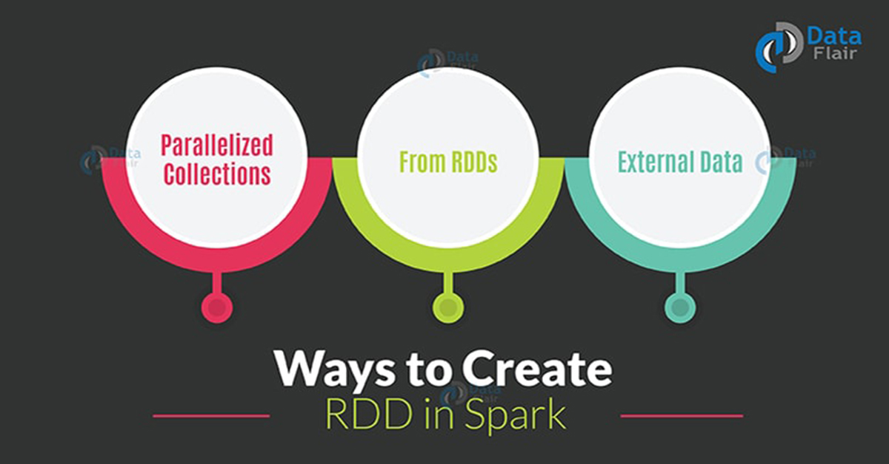
3 ways of creating RDDs in Spark
– Using parallelized collection, from existing Apache Spark RDDs and from external datasets.

Slide 21
i. Parallelized collection (parallelizing)
In the initial stage when we learn Spark, RDDs are generally created by parallelized collection i.e. by taking an existing collection in the program and passing it to SparkContext’sparallelize() method. This method is used in the initial stage of learning Spark since it quickly creates our own RDDs in Spark shell and performs operations on them. This method is rarely used outside testing and prototyping because this method requires entire dataset on one machine. Consider the following example of sortByKey(). In this, the data to be sorted is taken through parallelized collection:
val data=spark.sparkContext.parallelize(Seq(("maths",52),("english",75),("science",82), ("computer",65),("maths",85)))
val sorted = data.sortByKey()
sorted.foreach(println)

Slide 22
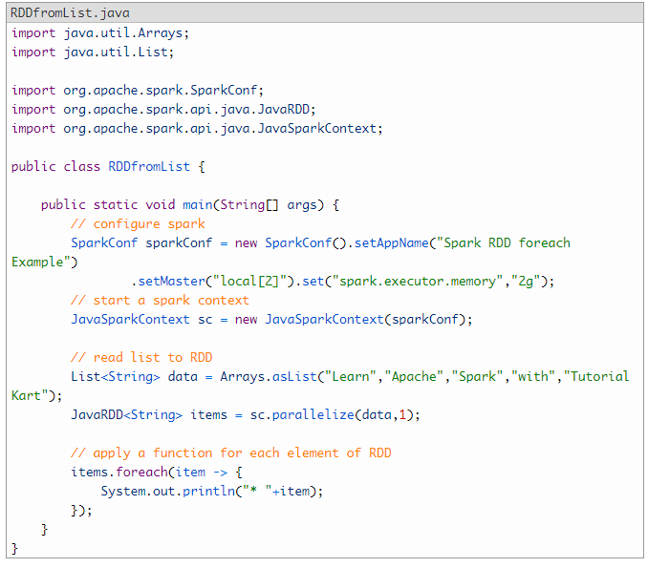
Create RDD from List<T> using Spark Parallelize.

Slide 23
The key point to note in parallelized collection is the number of partition the dataset is cut into. Spark will run one task for each partition of cluster. We require two to four partitions for each CPU in cluster. Spark sets number of partition based on our cluster. But we can also manually set the number of partitions. This is achieved by passing number of partition as second parameter to parallelize . e.g. sc.parallelize(data, 10), here we have manually given number of partition as 10. Consider one more example, here we have used parallelized collection and manually given the number of partitions: val rdd1 = spark.sparkContext.parallelize(Array("jan","feb","mar","april","may","jun"),3)
val result = rdd1.coalesce(2)
result.foreach(println)
ii. External Datasets (Referencing a dataset)
In Spark, the distributed dataset can be formed from any data source supported by Hadoop, including the local file system, HDFS, Cassandra, HBase etc. In this, the data is loaded from the external dataset. To create text file RDD, we can use SparkContext’s textFile method. It takes URL of the file and read it as a collection of line. URL can be a local path on the machine or a hdfs://, s3n://, etc The point to jot down is that the path of the local file system and worker node should be the same. The file should be present at same destinations both in the local file system and worker node. We can copy the file to the worker nodes or use a network mounted shared file system.

Slide 24
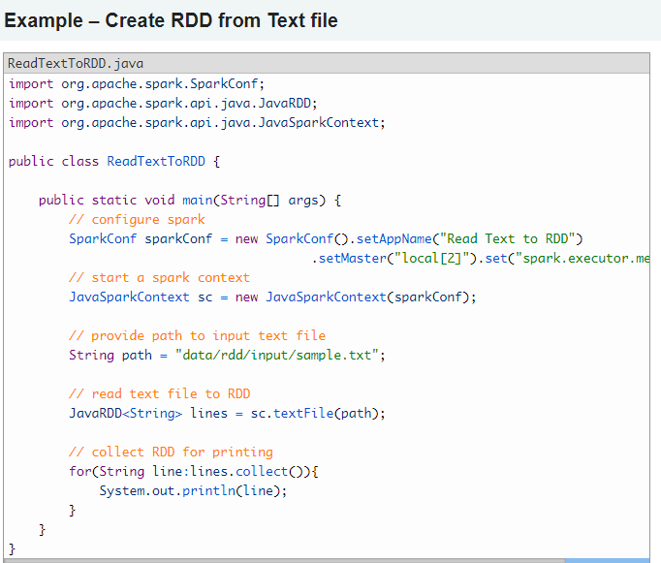
a. csv (String path)
It loads a CSV file and returns the result as a Dataset<Row>. Example: // read text files to RDD
JavaRDD<String> lines = sc.textFile("data/rdd/input/file1.csv");
Note – Here .rdd method is used to convert Dataset<Row> to RDD<Row>.
b. json (String path)

Slide 25
iii. Creating RDD from existing RDD
Transformation mutates one RDD into another RDD, thus transformation is the way to create an RDD from already existing RDD. This creates difference between Apache Spark and Hadoop MapReduce. Transformation acts as a function that intakes an RDD and produces one. The input RDD does not get changed, because RDDs are immutable in nature but it produces one or more RDD by applying operations. Some of the operations applied on RDD are: filter, count, distinct, Map, FlatMap etc. Example:
val words=spark.sparkContext.parallelize(Seq("the", "quick", "brown", "fox", "jumps", "over", "the", "lazy", "dog"))
val wordPair = words.map(w => (w.charAt(0), w))
wordPair.foreach(println)
Certain transformations can be pipelined which is an optimization method, that Spark uses to improve the performance of computations. There are two kinds of transformations: narrow transformation, wide transformation.

Slide 26
1. Spark RDD Operations
Two types of Apache Spark RDD operations are-
Transformations and Actions.
A Transformation is a function that produces new RDD from the existing RDDs but when we want to work with the actual dataset, at that point Action is performed.
Applying transformation built an RDD lineage, with the entire parent RDDs of the final RDD(s). RDD lineage, also known as RDD operator graph or RDD dependency graph. It is a logical execution plan i.e., it is Directed Acyclic Graph (DAG) of the entire parent RDDs of RDD.
Transformations are lazy in nature i.e., they get execute when we call an action. They are not executed immediately. Two most basic type of transformations is a map(), filter(). After the transformation, the resultant RDD is always different from its parent RDD. It can be smaller (e.g. filter, count, distinct, sample), bigger (e.g. flatMap(), union(), Cartesian()) or the same size (e.g. map).
There are two types of transformations:
Narrow transformation – In Narrow transformation, all the elements that are required to compute the records in single partition live in the single partition of parent RDD. A limited subset of partition is used to calculate the result. Narrow transformations are the result of map(), filter().

Slide 27
3.1. map(func)
The map function iterates over every line in RDD and split into new RDD. Using map() transformation we take in any function, and that function is applied to every element of RDD.
In the map, we have the flexibility that the input and the return type of RDD may differ from each other. For example, we can have input RDD type as String, after applying the
map() function the return RDD can be Boolean.
For example, in RDD {1, 2, 3, 4, 5} if we apply “rdd.map(x=>x+2)” we will get the result as (3, 4, 5, 6, 7).
3.2. flatMap()
With the help of flatMap() function, to each input element, we have many elements in an output RDD. The most simple use of flatMap() is to split each input string into words. Map and flatMap are similar in the way that they take a line from input RDD and apply a function on that line. The key difference between map() and flatMap() is map() returns only one element, while flatMap() can return a list of elements.

Slide 28
4. RDD Action
Transformations create RDDs from each other, but when we want to work with the actual dataset, at that point action is performed. When the action is triggered after the result, new RDD is not formed like transformation. Thus, Actions are Spark RDD operations that give non-RDD values. The values of action are stored to drivers or to the external storage system. It brings laziness of RDD into motion.
An action is one of the ways of sending data from Executer to the driver. Executors are agents that are responsible for executing a task. While the driver is a JVM process that coordinates workers and execution of the task. Some of the actions of Spark are:
Count(),
Collect(),
Reduce()
Aggregate()
Foreach()

Slide 29
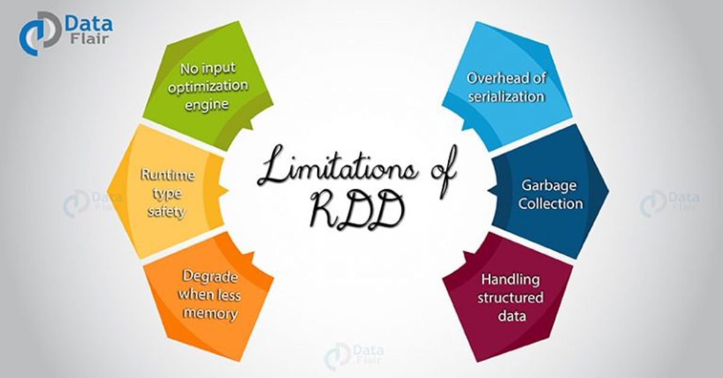

Slide 30
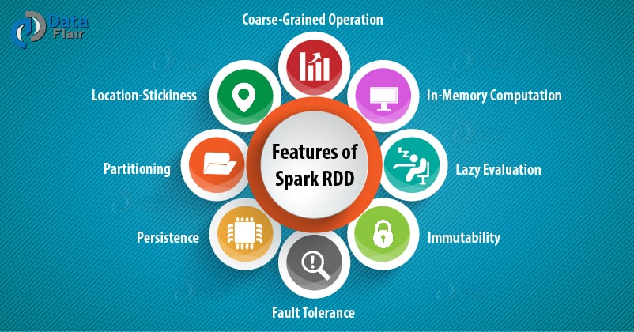
5. Features of Spark RDD
i. In-memory Computation
Spark RDDs have a provision of in-memory computation. It stores intermediate results in distributed memory(RAM) instead of stable storage(disk).

Slide 31
3. Introduction to Spark In-memory Computing (Must Read )
Keeping the data in-memory improves the performance by an order of magnitudes. The main abstraction of Spark is its RDDs.And the RDDs are cached using the cache() or persist()method.
When we use cache() method, all the RDD stores in-memory. When RDD stores the value in memory, the data that does not fit in memory is either recalculated or the excess data is sent to disk. Whenever we want RDD, it can be extracted without going to disk. This reduces the space-time complexity and overhead of disk storage. The in-memory capability of Spark is good for machine learning and micro-batch processing. It provides faster execution for iterative jobs.
When we use persist() method the RDDs can also be stored in-memory, we can use it across parallel operations. The difference between cache() and persist() is that using cache() the default storage level is MEMORY_ONLY while using persist() we can use various storage levels.
4. Storage levels of RDD Persist() in Spark
The various storage level of persist() method in Apache Spark RDD are:
MEMORY_ONLY
MEMORY_AND_DISK
MEMORY_ONLY_SER
MEMORY_AND_DISK_SER
DISK_ONLY
MEMORY_ONLY_2 and MEMORY_AND_DISK_2

Slide 32
LaZY Evaluation :-
Apache Spark evaluates RDDs lazily. It is called when needed, which saves lots of time and improves efficiency.
lazy evaluation in Spark means that the execution will not start until an action is triggered. In Spark, the picture of lazy evaluation comes when Spark transformations occur.
Transformations are lazy in nature meaning when we call some operation in RDD, it does not execute immediately. Spark maintains the record of which operation is being called(Through DAG). We can think Spark RDD as the data, that we built up through transformation. Since transformations are lazy in nature, so we can execute operation any time by calling an action on data. Hence, in lazy evaluation data is not loaded until it is necessary.
iii. Fault Tolerance
Spark RDDs are fault tolerant as they track data lineage information to rebuild lost data automatically on failure. They rebuild lost data on failure using lineage, each RDD remembers how it was created from other datasets (by transformations like a map, join or groupBy) to recreate itself.

Slide 33
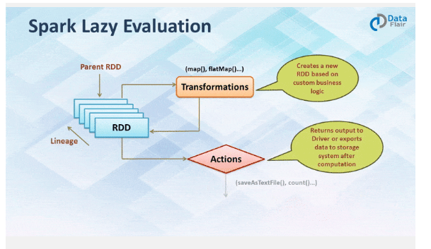
iv. Immutability
Data is safe to share across processes. It can also be created or retrieved anytime which makes caching, sharing & replication easy. Thus, it is a way to reach consistency in computations.
v. Partitioning
Partitioning is the fundamental unit of parallelism in Spark RDD. Each partition is one logical division of data which is mutable. One can create a partition through some transformations on existing partitions.
vi. Persistence
Users can state which RDDs they will reuse and choose a storage strategy for them (e.g., in-memory storage or on Disk).

Slide 34
Spark DStream (Discretized Stream) is the basic abstraction of Spark Streaming. DStream is a continuous stream of data. It receives input from various sources like Kafka, Flume, Kinesis, or TCP sockets. It can also be a data stream generated by transforming the input stream. At its core, DStream is a continuous stream of RDD (Spark abstraction). Every RDD in DStream contains data from the certain interval.
Any operation on a DStream applies to all the underlying RDDs. DStream covers all the details. It provides the developer a high-level API for convenience. As a result, Spark DStream facilitates working with streaming data.
Spark Streaming offers fault-tolerance properties for DStreams as that for RDDs. as long as a copy of the input data is available, it can recompute any state from it using the lineage of the RDDs. By default, Spark replicates data on two nodes. As a result, Spark Streaming can bear single worker failures.

Slide 35
2. Internals of How Apache Spark works?
Apache Spark is an open source, general-purpose distributed computing engine used for processing and analyzing a large amount of data. Just like Hadoop MapReduce, it also works with the system to distribute data across the cluster and process the data in parallel. Spark uses master/slave architecture i.e. one central coordinator and many distributed workers. Here, the central coordinator is called the driver.
The driver runs in its own Java process. These drivers communicate with a potentially large number of distributed workers called executors. Each executor is a separate java process. A Spark Application is a combination of driver and its own executors. With the help of cluster manager, a Spark Application is launched on a set of machines. Standalone Cluster Manager is the default built in cluster manager of Spark. Apart from its built-in cluster manager, Spark also works with some open source cluster manager like Hadoop Yarn, Apache Mesos etc.

Slide 36
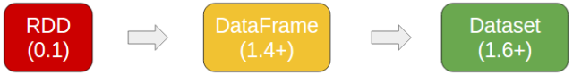
Spark has come up with two new types of data structures that have more benefits than RDD.
RDD's are
1. outdated
2. Hard to use
3. slow speed
Spark SQL is Spark module for structured data processing. It runs on top of Spark Core. It offers much tighter integration between relational and procedural processing, through declarative DataFrame and Datasets API.
DataFrame API and Datasets API are the ways to interact with Spark SQL. As a result, with Spark SQL, Apache Spark is accessible to more users and improves optimization for current ones.
Spark SQL introduces extensible optimizer called Catalyst as it helps in supporting a wide range of data sources and algorithms in Bigdata.

Slide 37
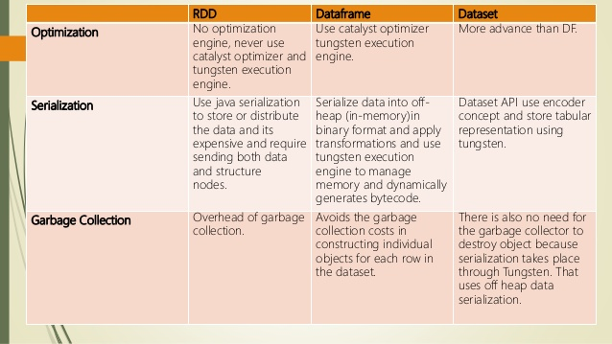
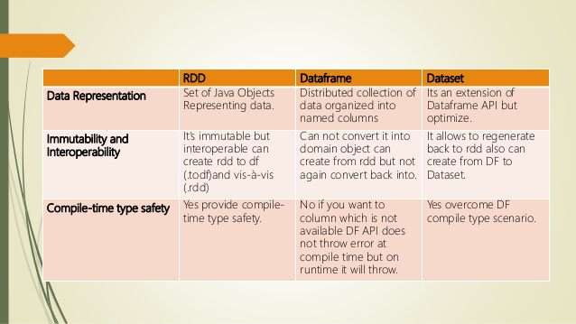

Slide 38
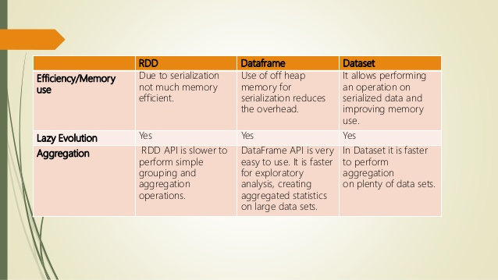

Slide 39
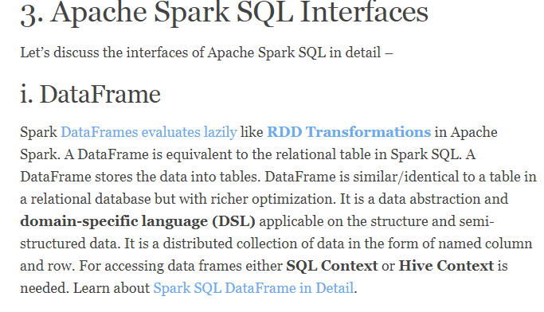

Slide 40
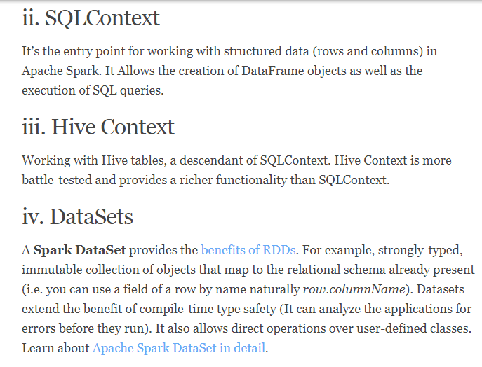
Datasets in Apache Spark are an extension of DataFrame API which provides type-safe, object-oriented programming interface. Dataset takes advantage of Spark’s Catalyst optimizer by exposing expressions and data fields to a query planner.

Slide 41
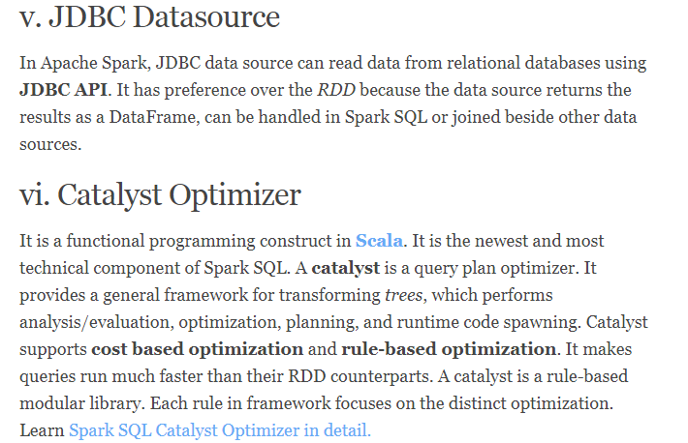

Slide 42
3. What are the Limitations of RDD in Apache Spark? Vs dataframe vs dataset
i. No input optimization engine
There is no provision in RDD for automatic optimization. It cannot make use of Spark advance optimizers like catalyst optimizer and Tungsten execution engine. We can optimize each RDD manually. This limitation is overcome in Dataset and DataFrame, both make use of Catalyst to generate optimized logical and physical query plan. We can use same code optimizer for R, Java, Scala, or Python DataFrame/Dataset APIs. It provides space and speed efficiency.
ii. Runtime type safety
There is no Static typing and run-time type safety in RDD. It does not allow us to check error at the runtime. Dataset provides compile-time type safety to build complex data workflows. Compile-time type safety means if you try to add any other type of element to this list, it will give you compile time error. It helps detect errors at compile time and makes your code safe.

Slide 43
iii. Degrade when not enough memory
The RDD degrades when there is not enough memory to store RDD in-memory or on disk. There comes storage issue when there is a lack of memory to store RDD. The partitions that overflow from RAM can be stored on disk and will provide the same level of performance. By increasing the size of RAM and disk it is possible to overcome this issue.
iv. Performance limitation & Overhead of serialization & garbage collection
Since the RDD are in-memory JVM object, it involves the overhead of Garbage Collection and Java serialization this is expensive when the data grows. Since the cost of garbage collection is proportional to the number of Java objects. Using data structures with fewer objects will lower the cost. Or we can persist the object in serialized form.
v. Handling structured data
RDD does not provide schema view of data. It has no provision for handling structured data. Dataset and DataFrame provide the Schema view of data. It is a distributed collection of data organized into named columns.

Slide 44
The key point to note in parallelized collection is the number of partition the dataset is cut into. Spark will run one task for each partition of cluster. We require two to four partitions for each CPU in cluster. Spark sets number of partition based on our cluster. But we can also manually set the number of partitions. This is achieved by passing number of partition as second parameter to parallelize . e.g. sc.parallelize(data, 10), here we have manually given number of partition as 10.

Slide 45
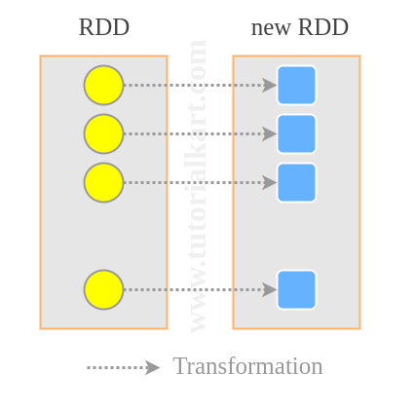
Syntax
Difference between Spark Map vs FlatMap Operation
Spark Map Transformation
A map is a transformation operation in Apache Spark. It applies to each element of RDD and it returns the result as new RDD. In the Map, operation developer can define his own custom business logic. The same logic will be applied to all the elements of RDD.
Spark Map function takes one element as input process it according to custom code (specified by the developer) and returns one element at a time. Map transforms an RDD of length N into another RDD of length N. The input and output RDDs will typically have the same number of records
RDD.map(<function>)
// map each line to number of words in the line
JavaRDD<Integer> n_words = lines.map(x > x.split(" ").length);

Slide 46
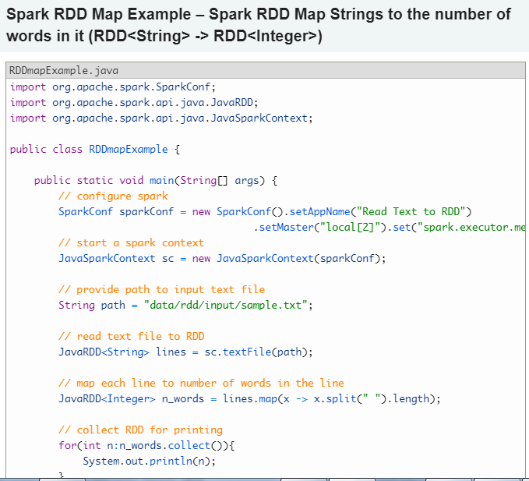

Slide 47
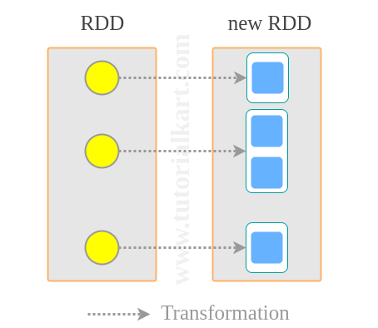
A flatMap is a transformation operation. It applies to each element of RDD and it returns the result as new RDD. It is similar to Map, but FlatMap allows returning 0, 1 or more elements from map function. In the FlatMap operation, a developer can define his own custom business logic. The same logic will be applied to all the elements of the RDD.
A FlatMap function takes one element as input process it according to custom code (specified by the developer) and returns 0 or more element at a time. flatMap() transforms an RDD of length N into another RDD of length M.
JavaRDD words =
lines.flatMap(line -> Arrays.asList(line.split(" ")));
Above flatMap transformation will convert a line into words. One word will be an individual element of the newly created RDD.

Slide 48
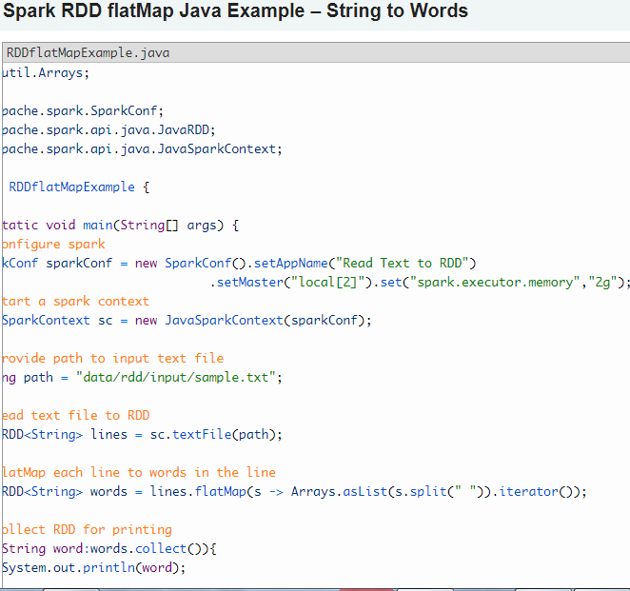

Slide 49
Java 7 word count:
JavaRDD lines = sc.textFile("hdfs://log.txt");
// Map each line to multiple words
JavaRDD words = lines.flatMap(
new FlatMapFunction() {
public Iterable call(String line) {
return Arrays.asList(line.split(" "));
}
});
// Turn the words into (word, 1) pairs
JavaPairRDD ones = words.mapToPair(
new PairFunction() {
public Tuple2 call(String w) {
return new Tuple2(w, 1);
}
});
// Group up and add the pairs by key to produce counts
JavaPairRDD counts = ones.reduceByKey(
new Function2() {
public Integer call(Integer i1, Integer i2) {
return i1 + i2;
}
});
counts.saveAsTextFile("hdfs://counts.txt");

Slide 50
With Java 8, we can write this program in just a few lines:
Java 8 word count:
to convert line ---> words use flatmap()/map()
to convert word (hello) into key value (hello,1) use mapToPair()
JavaRDD lines = sc.textFile("hdfs://log.txt");
JavaRDD words =
lines.flatMap(line -> Arrays.asList(line.split(" ")));
JavaPairRDD counts =
words.mapToPair(w -> new Tuple2(w, 1))
.reduceByKey((x, y) -> x + y);
counts.saveAsTextFile("hdfs://counts.txt");

Slide 51
Spark Streaming vs. Kafka Streaming
If event time is very relevant and latencies in the seconds range are completely unacceptable, Kafka should be your first choice. Otherwise, Spark works just fine.

Slide 52
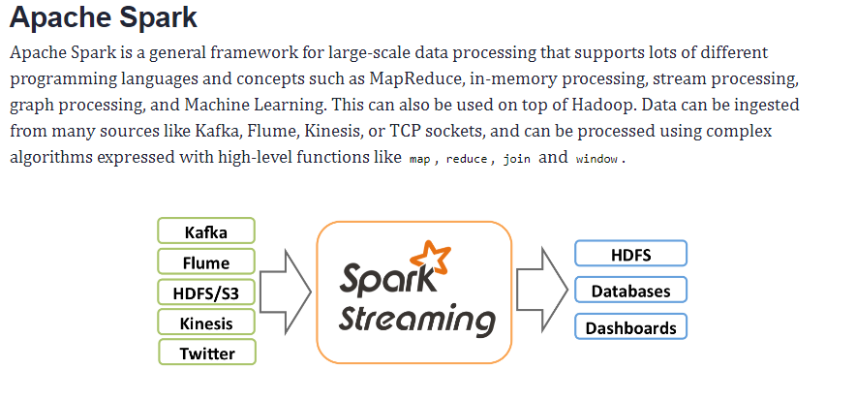
2. What is Apache Spark Streaming?
A data stream is an unbounded sequence of data arriving continuously. Streaming divides continuously flowing input data into discrete units for further processing. Stream processing is low latency processing and analyzing of streaming data.
Stream processing is the real-time processing of data continuously and concurrently.
Spark Streaming was added to Apache Spark in 2013, an extension of the core Spark API that provides scalable, high-throughput and fault-tolerant stream processing of live data streams. Data ingestion can be done from many sources like Kafka, Apache Flume, Amazon Kinesis or TCP sockets and processing can be done using complex algorithms that are expressed with high-level functions like map, reduce, join and window. Finally, processed data can be pushed out to filesystems, databases and live dashboards.

Slide 53
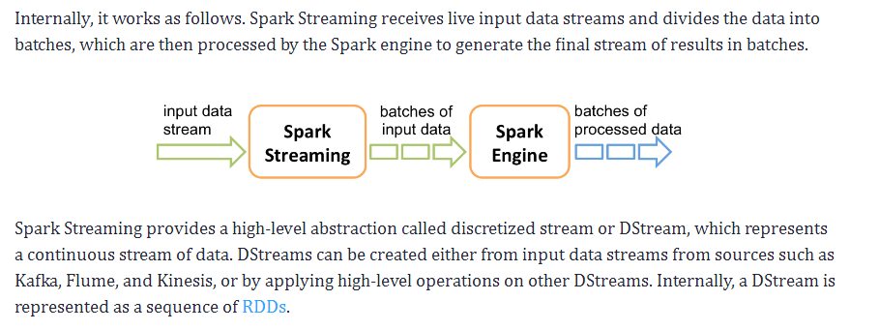
By default, Spark replicates data on two nodes. As a result, Spark Streaming can bear single worker failures.
Any operation on a DStream applies to all the underlying RDDs.

Slide 54
Stateless transformations are capable of combining data from many DStreams within each time step. For example, key/value DStreams have the same join-related transformations as RDDs— cogroup(), join(), leftOuterJoin() etc.
If stateless transformations are insufficient, DStreams comes with an advanced operator called transform(). transform() allow operating on the RDDs inside them. The transform() allows any arbitrary RDD-to-RDD function to act on the DStream. This function gets called on each batch of data in the stream to produce a new stream.
b. Stateful Transformations
It uses data or intermediate results from previous batches and computes the result of the current batch. Stateful transformations are operations on DStreams that track data across time. Thus it makes use of some data from previous batches to generate the results for a new batch.
The two main types are windowed operations, which act over a sliding window of time periods, and updateStateByKey(), which is used to track state across events for each key (e.g., to build up an object representing each user session).

Slide 55
Any operation on a DStream applies to all the underlying RDDs. DStream covers all the details. It provides the developer a high-level API for convenience. As a result, Spark DStream facilitates working with streaming data.
Spark Streaming offers fault-tolerance properties for DStreams as that for RDDs. as long as a copy of the input data is available, it can recompute any state from it using the lineage of the RDDs. By default, Spark replicates data on two nodes. As a result, Spark Streaming can bear single worker failures.
3. Apache Spark DStream Operations
Like RDD, Spark DStream also support two types of Operations: Transformations and output Operations-
i. Transformation
There are two types of transformation in DStream:
Stateless Transformations
Stateful Transformations
a. Stateless Transformations
The processing of each batch has no dependency on the data of previous batches. Stateless transformations are simple RDD transformations. It applies on every batch meaning every RDD in a DStream. It includes common RDD transformations like map(), filter(), reduceByKey() etc. Although these functions seem like applying to the whole stream, each DStream is a collection of many RDDs (batches). As a result, each stateless transformation applies to each RDD.

Slide 56
i. Output Operation
Once we get the data after transformation, on that data output operation are performed in Spark Streaming. After the debugging of our program, using output operation we can only save our output. Some of the output operations are print(), save() etc.. The save operation takes directory to save file into and an optional suffix. The print() takes in the first 10 elements from each batch of the DStream and prints the result.

Slide 57
4. Input DStreams and Receivers
Input DStream is a DStream representing the stream of input data from streaming source. Receiver (Scala doc, Java doc) object associated with every input DStream object. It receives the data from a source and stores it in Spark’s memory for processing.
Spark Streaming provides two categories of built-in streaming sources:
Basic sources – These are Source which is directly available in the StreamingContext API. Examples: file systems, and socket connections.
Advanced Sources – These sources are available by extra utility classes like Kafka, Flume, Kinesis. Thus, requires linking against extra dependencies.
For example:
Kafka: the artifact required for Kafka is spark-streaming-kafka-0-8_2.11.
Flume: the artifact requires for Flume is dspark-streaming-flume_2.11.
Kinesis: the artifact required for Kinesis is spark-streaming-kinesis-asl_2.11.
It creates many inputs DStream to receive multiple streams of data in parallel. It creates multiple receivers that receive many data stream. Spark worker/executor is a long-running task. Thus, occupies one of the cores which associate to Spark Streaming application. So, it is necessary that, Spark Streaming application has enough cores to process received data.

Slide 60
6. Determining Memory Consumption in Spark
If we want to know the size of Spark memory consumption a dataset will require to create an RDD, put that RDD into the cache and look at “Storage” page in Web UI. This page will let us know the amount of memory RDD is occupying. If we want to know the memory consumption of particular object, use SizeEstimator’S estimate method.
c. Broadcasting Large Variables
The size of each serialized task reduces by using broadcast functionality in SparkContext. If a task uses a large object from driver program inside of them, turn it into the broadcast variable. Generally, it considers the tasks that are about 20 Kb for optimization.
a. Level of Parallelism
To use the full cluster the level of parallelism of each program should be high enough. According to the size of the file, Spark sets the number of “Map” task to run on each file. The level of parallelism can be passed as a second argument. We can set the config property spark.default.parallelism to change the default

Slide 61
d. Data Locality in Apache Spark
Data locality plays an important role in the performance of Spark Jobs. The case in which the data and code that operates on that data are together, the computation is faster. But if the two are separate, then either the code should be moved to data or vice versa. It is faster to move serialized code from place to place then the chunk of data because the size of the code is smaller than the data.
Based on data current location there are various levels of locality. The order from closest to farthest is:
The best possible locality is that the PROCESS_LOCAL resides in same JVM as the running code.
NODE_LOCAL resides on the same node in this. It is because the data travel between processes is quite slower than PROCESS_LOCAL.
There is no locality preference in NO_PREF data is accessible from anywhere.
RACK_LOCAL data is on the same rack of the server. Since the data is on the same rack but on the different server, so it sends the data in the network, through a single switch.
ANY data resides somewhere else in the network and not in the same rack.

Slide 62
Must READ **
What are the differences and similarities between Kafka and Spark Streaming?
Kafka is a message broker with really good performance so that all your data can flow through it before being redistributed to applications
Spark Streaming is one of these applications, that can read data from Kafka.
Kafka and Spark Streaming work along well together!
Now, the more interesting question:
What are the differences and similarities between Kafka STREAMS library and Spark Streaming?
and the more interesting answer:
Historically, any streaming library (Spark, Flink, NiFi, name it) uses Kafka for a message broker and that’s it. Read the messages from Kafka, and forget they even came from Kafka. These libraries also implement sometimes mini-batching which some argue is not exactly “streaming”.
Then came Kafka Streams. It’s the first library that I know, that FULLY utilises Kafka for more than being a message broker. The explanation could go on and on and on, but basically, when Kafka Streams performs aggregations, filtering, etc etc, it writes back the data to Kafka. That is amazing for scalability, high availability, etc. It also does not do mini batching, which is “real streaming”.
Please note that I believe that Kafka Streams is still best used in a ‘Kafka -> Kafka’ context, while Spark Streaming could be used for a ‘Kafka -> Database’ or ‘Kafka -> Data science model’ type of context.

Slide 63
One of the biggest difference is Spark uses micro batching for streaming data. In easy terms if collects data for some time, build RDD and then process these micro batches. Think about RDD as the underlying concept for distributing data over a cluster of computer.
Kafka on the other hand completely different purpose. Think about data piping that connect with different sources. So data is collected form different sources and feed into a processing engine like Spark. Kafka do this on scale and has a very high throughput if configured correctly.
These 2 technologies when connected each other bring the complete data collection and processing capabilities.

